Slide 1
Statistical Tests
Saravana

Slide 2
What is the statistical Score?

Slide 3
Critical values and p values

Slide 4
When the P value should be less than 5 percent and when it should be more than 5 percent?

Slide 5
Type of Test | Use
Correlational: these tests look for an association between variables
Pearson Correlation | Tests for the strength of the association between two continuous variables
Chi-Square | Tests for the strength of the association between two categorical variables
Comparison of Means: these tests look for the difference between the means of variables
One Sample T-Test | Test the difference between a sample mean and a known or hypothesized value of the mean in the population
Paired T-Test | Tests for the difference between two variables from the same population (e.g., a pre- and posttest score)
Independent T-Test | Tests for the difference between the same variable from different populations (e.g., comparing boys to girls)
One Sample Z-Test | test whether a population parameter is significantly different from some hypothesized value
Two Sample Z-Test | Tests for the difference between two variables from the same population
ANOVA | Tests for the difference between group means after any other variance in the outcome variable is accounted for (e.g., controlling for sex, income, or age)
Regression: these tests assess if change in one variable predicts change in another variable
Simple Regression | Tests how change in the predictor variable predicts the level of change in the outcome variable
Multiple Regression | Tests how changes in the combination of two or more predictor variables predict the level of change in the outcome variable

Slide 6
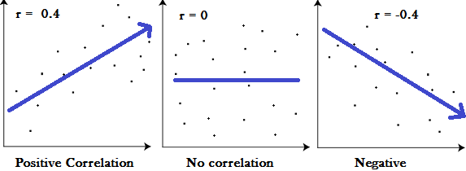
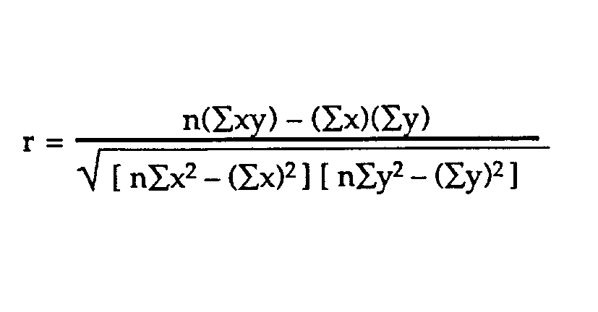
Correlation coefficient
A correlation coefficient is a way to put a value to the relationship

Slide 7
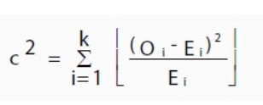
Chi Square Test
chi-square goodness of fit test
chi-square test for independence
A very small chi square test statistic means that your observed data fits your expected data extremely well. In other words, there is a relationship.
A very large chi square test statistic means that the data does not fit very well. In other words, there isn’t a relationship.
Chi Square Table

Slide 8
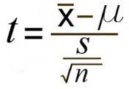
One Sample T Test
Sample Question:- Your company wants to improve sales. Past sales data indicate that the average sale was $100 per transaction. After training your sales force, recent sales data (taken from a sample of 25 salesmen) indicates an average sale of $130, with a standard deviation of $15. Did the training work? Test your hypothesis at a 5% alpha level.
Null Hypothesis
Alternate Hypothesis
Identify the Sample Mean
Identify the Population Mean
Identify the Sample Standard Deviation
Number of Observations
Calculate & Find the t value in the Table
Accept or Reject the Null Hypothesis
Conclude about the Experiment
One Tailed T Table

Slide 9
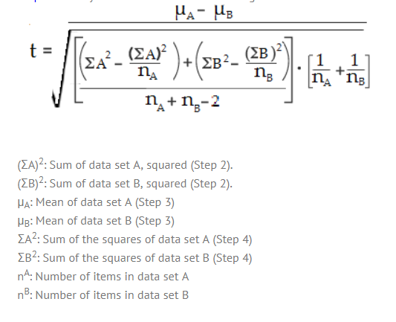
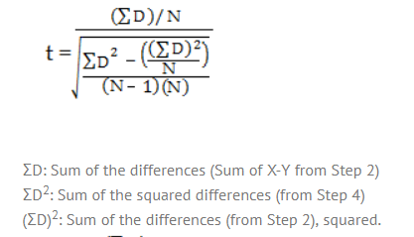
Independent & Paired T Tests
Independent Tests- implies that the two samples must have come from two completely different populations.
On the other hand, if your samples are connected in some way, run a Paired samples t-test.

Slide 10
ANOVA
One-way ANOVA between groups: used when you want to test two groups to see if there’s a difference between them
Two way ANOVA without replication: used when you have one group and you’re double-testing that same group. For example, you’re testing one set of individuals before and after they take a medication to see if it works or not
Two way ANOVA with replication: Two groups, and the members of those groups are doing more than one thing

Slide 11
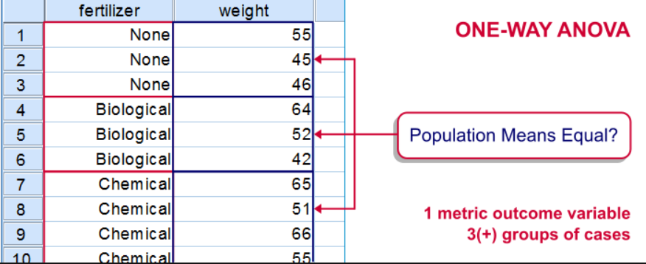
One way ANOVA
Two Way ANOVA
A Two Way ANOVA is an extension of the One Way ANOVA. With a One Way, you have one independent variable affecting a dependent variable. With a Two Way ANOVA, there are two independents

Slide 12
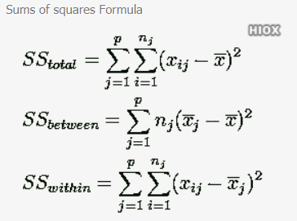
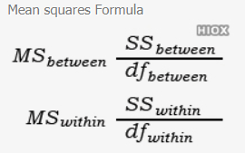
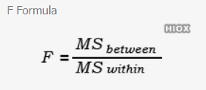
One way ANOVA
One way ANOVA matrix calculator is used to test the equality of samples by using variance.

Slide 13
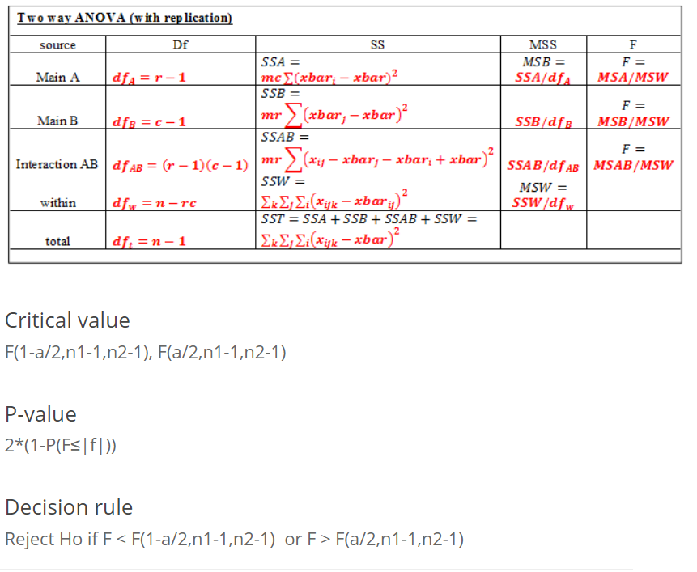

Slide 14
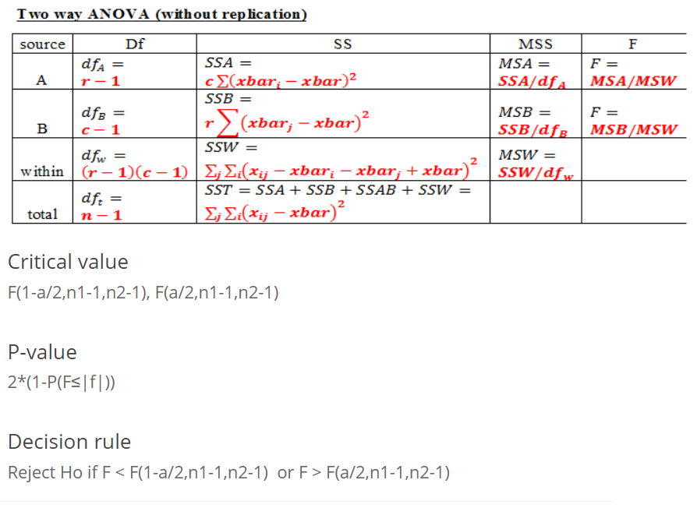

Slide 15
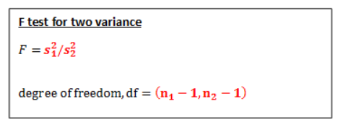
F test for variance
Null and Alternative Hypothesis
Ho: σ1=σ2
Ha1: σ1≠σ2 (Two tailed test)
Ha2: σ1<σ2 (Left tailed test)
Ha3: σ1>σ2 (Right tailed test)
Critical value
-F(1-a/2,n1-1,n2-1), F(1-a/2,n1-1,n2-1) (Two tailed test)
F(1-a,n1-1,n2-1) (Left tailed test)
F(a,n1-1,n2-1) (Right tailed test)
P-value
2*(1-P(F≤|f|) (Two tailed test)
P(F≤f) (Left tailed test)
P(F≥f) (Right tailed test)
Decision rule
Reject Ho if F < F(1-a/2,n1-1,n2-1) or F > F(a/2,n1-1,n2-1) or p-value < alpha (two tailed test)
Reject Ho if F < F(1-a,n1-1,n2-1) or p-value < alpha (left tailed test)
Reject Ho if F > F(a,n1-1,n2-1) or p-value < alpha (right tailed test)

Slide 16
Resources
https://towardsdatascience.com/hypothesis-testing-in-machine-learning-using-python-a0dc89e169ce
https://machinelearningmastery.com/how-to-transform-data-to-fit-the-normal-distribution/

